Slide 1
Security Mechanism for Hadoop Systems
ITMS 528
Arjun Venkatesh

Slide 2
Overview
What is Big Data
Hadoop Architecture
Authentication Mechanism in Hadoop
Authorization Mechanism in Hadoop
Apache Knox
Encryption Mechanism in Hadoop

Slide 3

What is Big Data
No standard single definition
Big data is a collection of data from traditional and digital sources inside and outside a company that represents a source for ongoing discovery and analysis. --Forbes.com
Big data is the realization of greater business intelligence by storing, processing, and analyzing data that was previously ignored due to the limitations of traditional data management technologies. --Gartner Insight

Slide 4
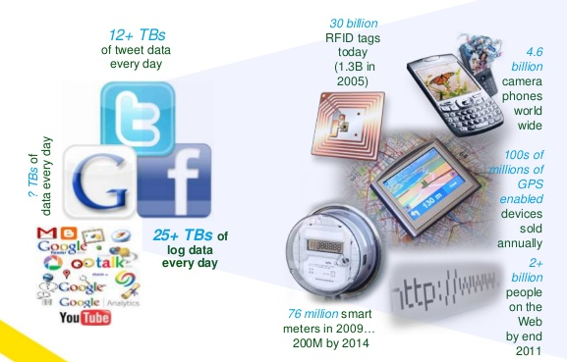
Data.. Data.. Everywhere!!
2.5 quintillion bytes of data are generated every day!
A quintillion is 10¹⁸
Data come from many quarters.
Social media sites
Airplane’s/Ship’s Black box data
Sensors
Digital photos
Business transactions
Location-based data

Slide 5
4 V Dimensions of Big Data
Volume: Large volumes of data
Velocity: Quickly moving data
Variety: structured, unstructured, images, etc.
Veracity: Trust and integrity is a challenge and a must and is important for big data just as for traditional relational DBs

Slide 6
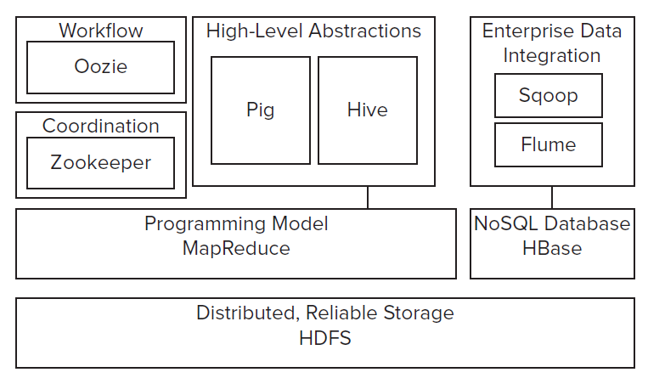
Hadoop Architecture
Block Diagram

Slide 7
Authentication Mechanism in Hadoop

Slide 8
Kerberos Authentication
What is Kerberos?
Kerberos is an authentication protocol for “trusted hosts on untrusted networks” and it also privileges Single-Sign-On (SSO) for users and servers in an open network. Hadoop uses this authentication mechanism to acknowledge users trying to access Hadoop application along with Hadoop internal services to one another.
What Does Kerberos do?
Establishes identity for clients, hosts and services
Prevent impersonation/password are never sent over wire
Integrates with enterprise identity management such as LDAP
More granular auditing of data access/ job execution

Slide 9
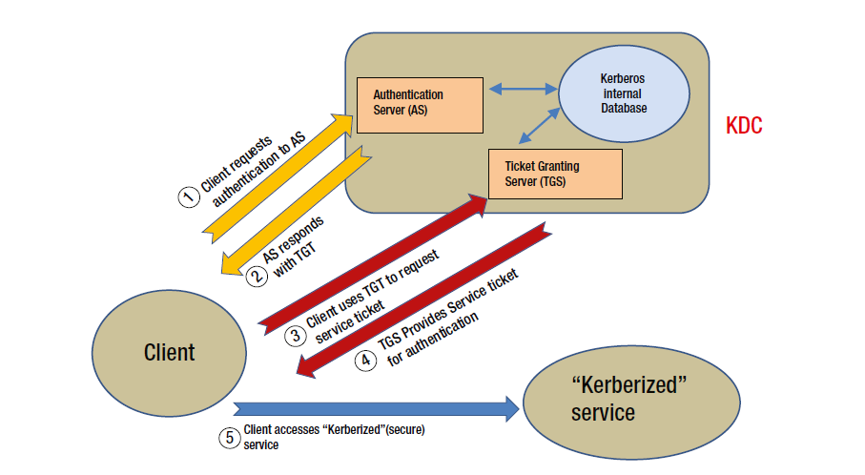
Kerberos contd..
Kerberos Authentication flow.

Slide 10
Kerberos contd..
Kerberos RPC Mechanism
Kerberos Mechanism for Web
It uses Simple Authentication and Security Layer (SASL) through Kerberos 5 module incorporated to it. The SASL further implements Generic Security Service Application Program Interface (GSSAPI) which as a whole is referred as Kerberos RPC.
SASL allows authentication protocol to be negotiated and GSSAPI is the top end API that implements the Kerberos.
Kerberos RPC is configured in core-site.xml and mapred-site.xml
Hadoop is embedded with Auth which provides HTTP SPNEGO authentication for protection of web apps.
The Auth sets a signed HTTP cookie that contains a token for Kerberos Authentication.
Auth is set up by setting up a keytab and a principal to use to protect a resource, this is configured in the web app’s WEB-INF/web.xml file.

Slide 11
Oozie based Authentication
Oozie is an associate system that can be used to manage Hadoop jobs.
Oozie accepts workflows and then submits them to HDFS and MapReduce. It also accepts workflows via a web interface and interacts with Hadoop elements on behalf of the user, who submitted the task.
Oozie is configured to support Kerberos RPC (KRPC) and HTTP SPNEGO authentication.
For KRPC, the Oozie service user principal must be created and will be added to Kerberos realm.
For HTTP SPNEGO, It is to be configured to use the same HTTP principal and keytab file.
Oozie’s configuration file, “oozie-site.xml” where the parameters for authentication is configured.

Slide 12
Authorization Mechanism in Hadoop

Slide 13
Job Authorization
This controls who can submit, view or manage jobs (Pig, Hive, Map Reduce…)
Provides ACL’s (Access Control List) for Hadoop Scheduler Queues, Manage and View jobs.
mapred-site.xml file is the main file where parameters are needed to be configured.

Slide 14
Service Level Authorization
This controls which users have permission to particular services.
Also ensures that clients which connect to HDFS have necessary permissions to access HDFS and it can control users having permissions to submit MapReduce jobs.
Files that control SLA parameters are: core-site.xml and hadoop-policy.xml

Slide 15
Apache Knox

Slide 16
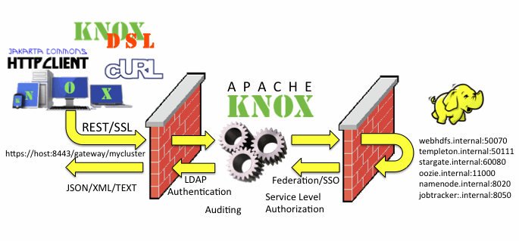
Apache Knox
What is Apache Knox?
The Apache Knox Gateway is a REST API Gateway for interrelating with Hadoop clusters. The Knox Gateway offers a single entry point for all REST communications with the Hadoop clusters.
Knox Architecture

Slide 17

Apache Knox Contd..
Why Apache Knox?
REST/HTTP API Security for Hadoop
Single REST API access point
Centralized Authentication, Authorization for Hadoop REST/HTTP services.
LDAP/AD Authentication.
Eliminates client’s requirements for intimate knowledge of cluster topology

Slide 18
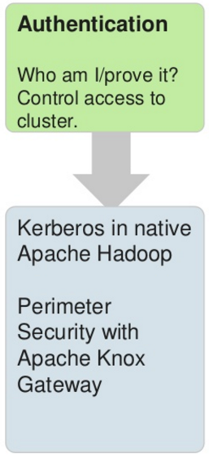
Authentication Using Knox
The Apache Knox Gateway is a system that provides a single point of authentication and access for Apache Hadoop services in a cluster
Provides authentication and token verification at the perimeter.
Enables authentication integration with enterprise and cloud identity management systems.
Integrates with OpenLDAP, ApacheDS and Microsoft Active Directory for basic verification of user credentials.

Slide 19
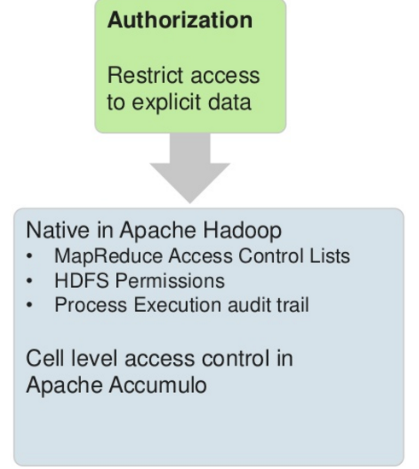
Authorization Using Knox
Knox Gateway provides an ACL based authorization provider that evaluates rules that comprise of username, groups and ip addresses.
ACL can be applied on HDFS and Hive component using Knox.
Provides Service level authorization i.e. ACLs protect resources and protect access to the Hadoop services themselves based on users and groups.

Slide 20
Encryption Mechanism in Hadoop

Slide 21
Network Encryption
RPC Encryption
HDFS Data Transfer Encryption
Web Encryption
Parameters for network encryption are configured in:
core-site.xml
hadoop.ssl.enabled
hadoop.ssl.hostname .verifier
hadoop.ssl.require .client.cert
hadoop.ssl.keystores.factory.class
hadoop.ssl.client.conf
hadoop.ssl.server.conf
hdfs-site.xml
dfs.encrypt.data .transfer

Slide 22
Data Encryption
Lowest level of encryption is volume encryption, that can encrypt all the data on a node and doesn’t require any changes to Hadoop.
The volume-level encryption provides protection against physical security but lacks a fine-grained approach.
The encryption is done only to selected files/directories in HDFS to protect performance

Slide 23
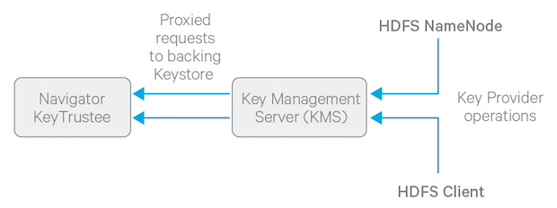
The Data encryption solution consists of
Encryption Zone: The HDFS creates an encryption zone and is linked to an empty HDFS directory and an encryption key. Any files put in the directory are automatically encrypted by HDFS.
Key Management Server (KMS): KMS is responsible for storing encryption key. It provides API and access on keys stored in KMS.
Key Provider API: The Key Provider API is the glue used to hold HDFS Name Node and Client to connect with KMS.

Slide 24


